Slide 1

Introduction to website
We are running a world class Law Firm Named Athema Law Firm.
Our firm won so many awards for our outstanding work all over the world and we are currently present in more than 7 countries.
We Provide our support all over 7 countries from our website
And introduction and use of our website are given forward.

Slide 2
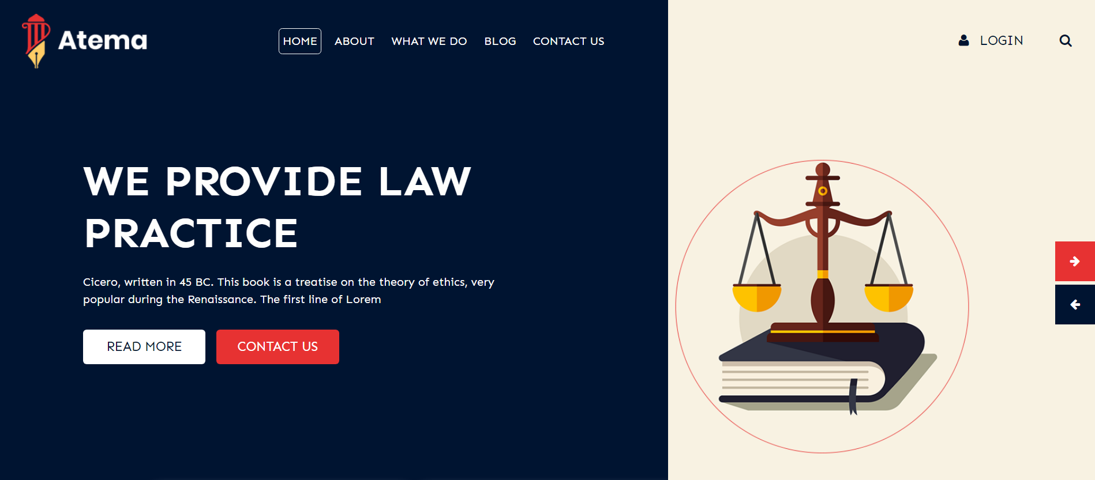
This Is From Page Of Our Website. In our front page we have Home, About, What We Do, Blog And Contact Us Option. Also We Have log in button for our admin users.

Slide 3
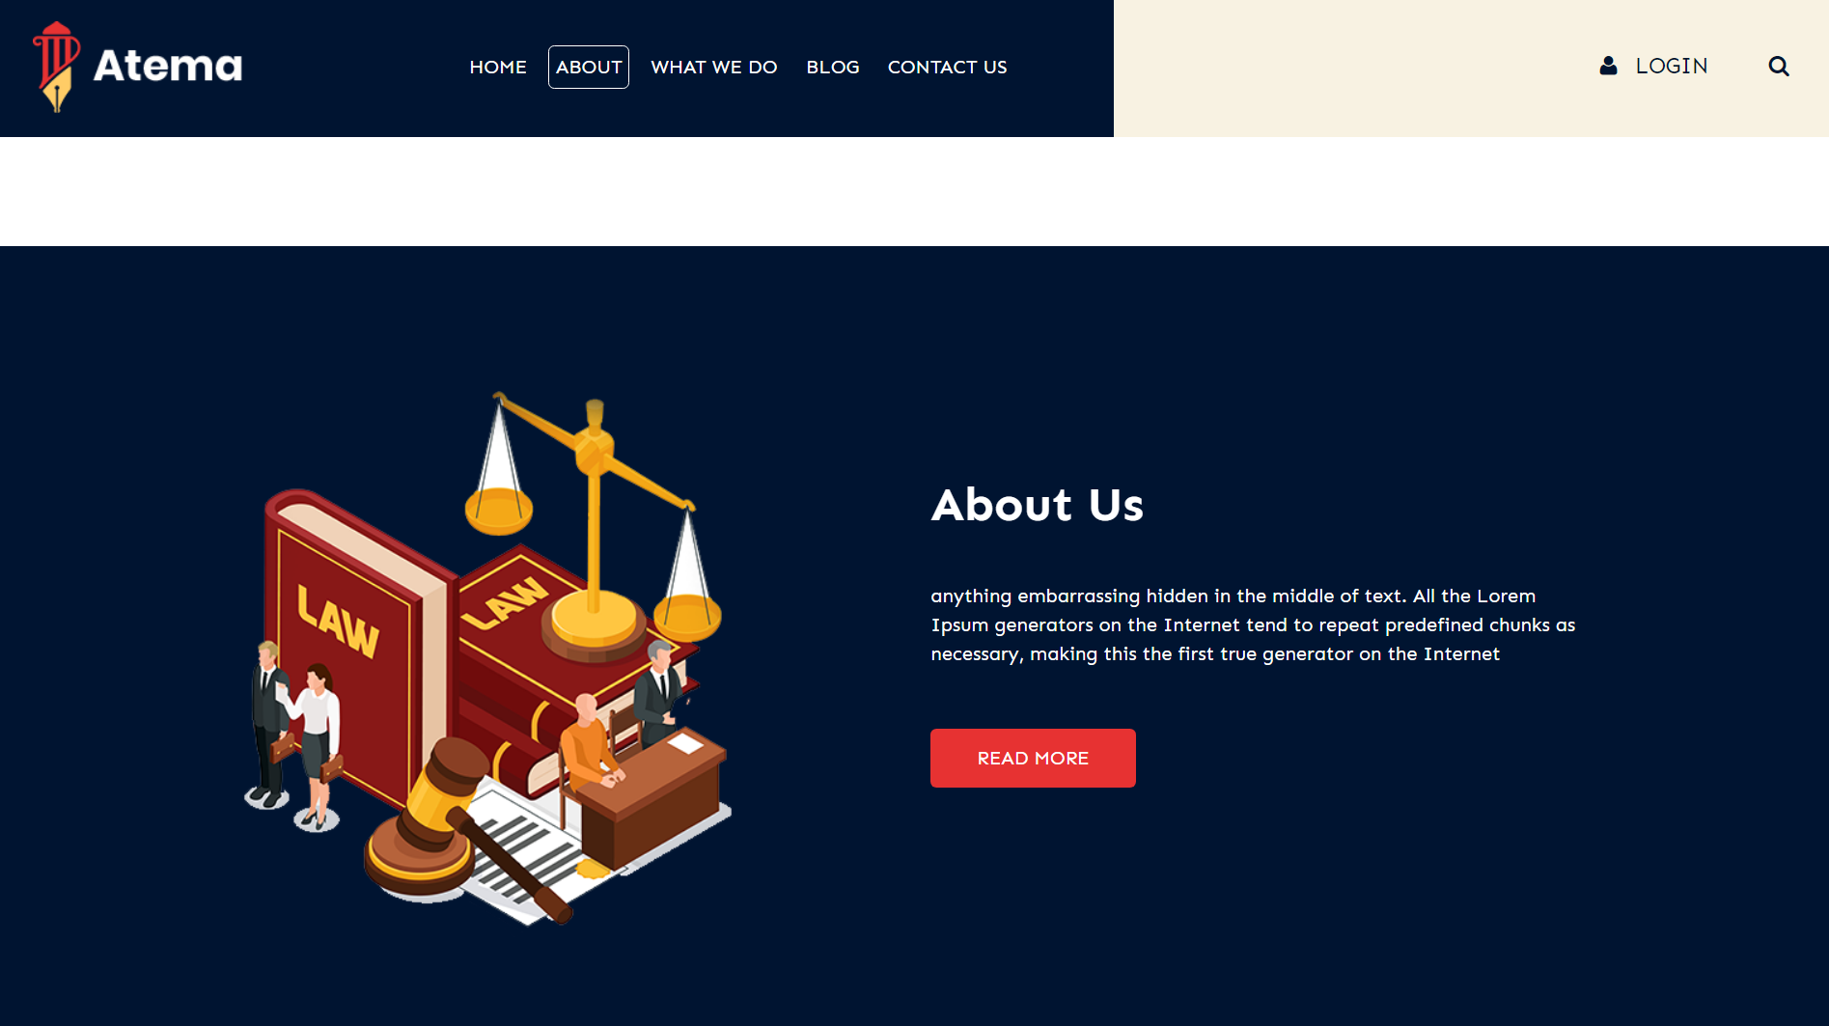
This Is Our About Section Where We Mention Whole Details Of Our Firm.

Slide 4
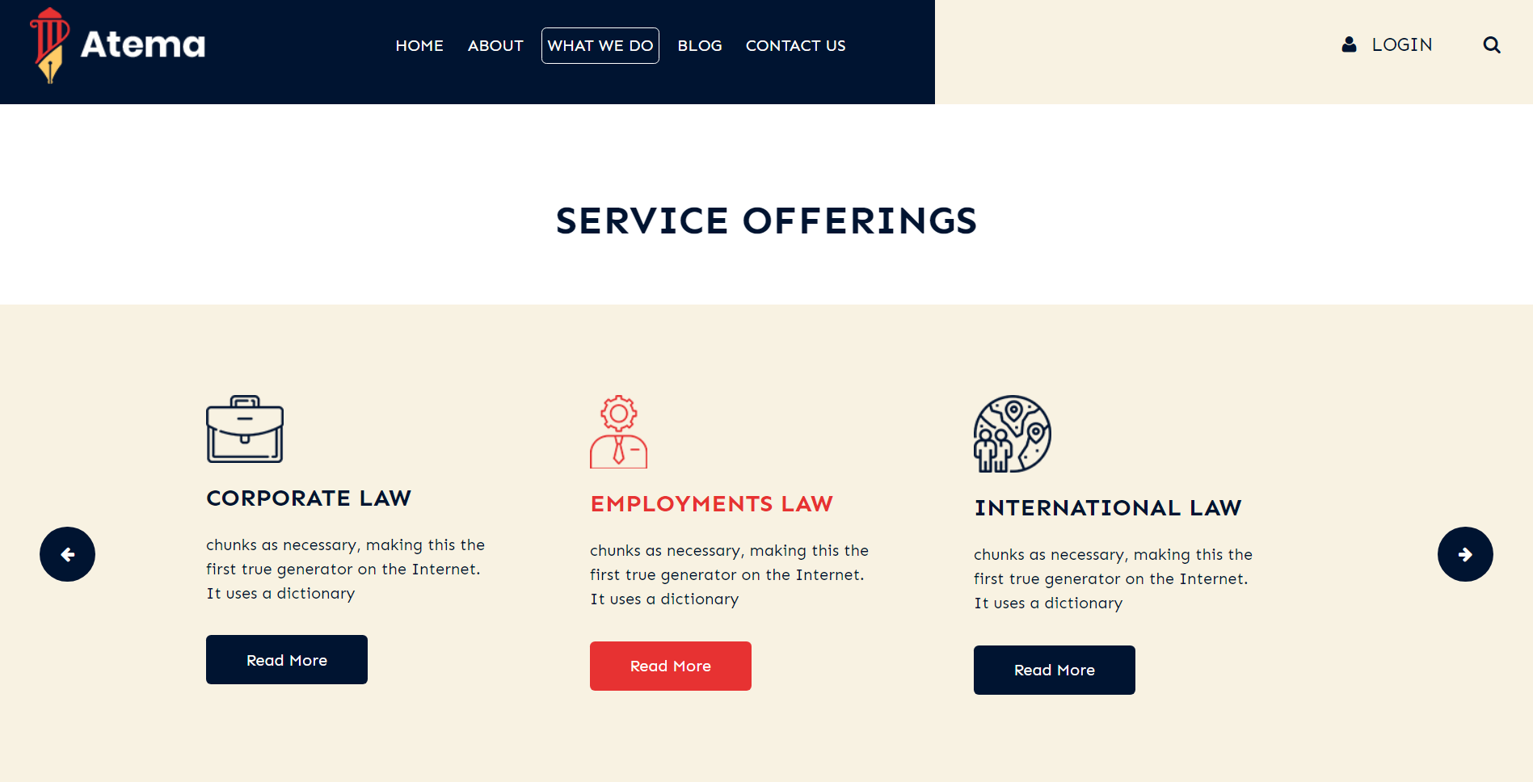
The Is Our Services Page Where We Mention Our Services. You Can Directly Know About Our All Type Of Service From Here Which We Provided

Slide 5
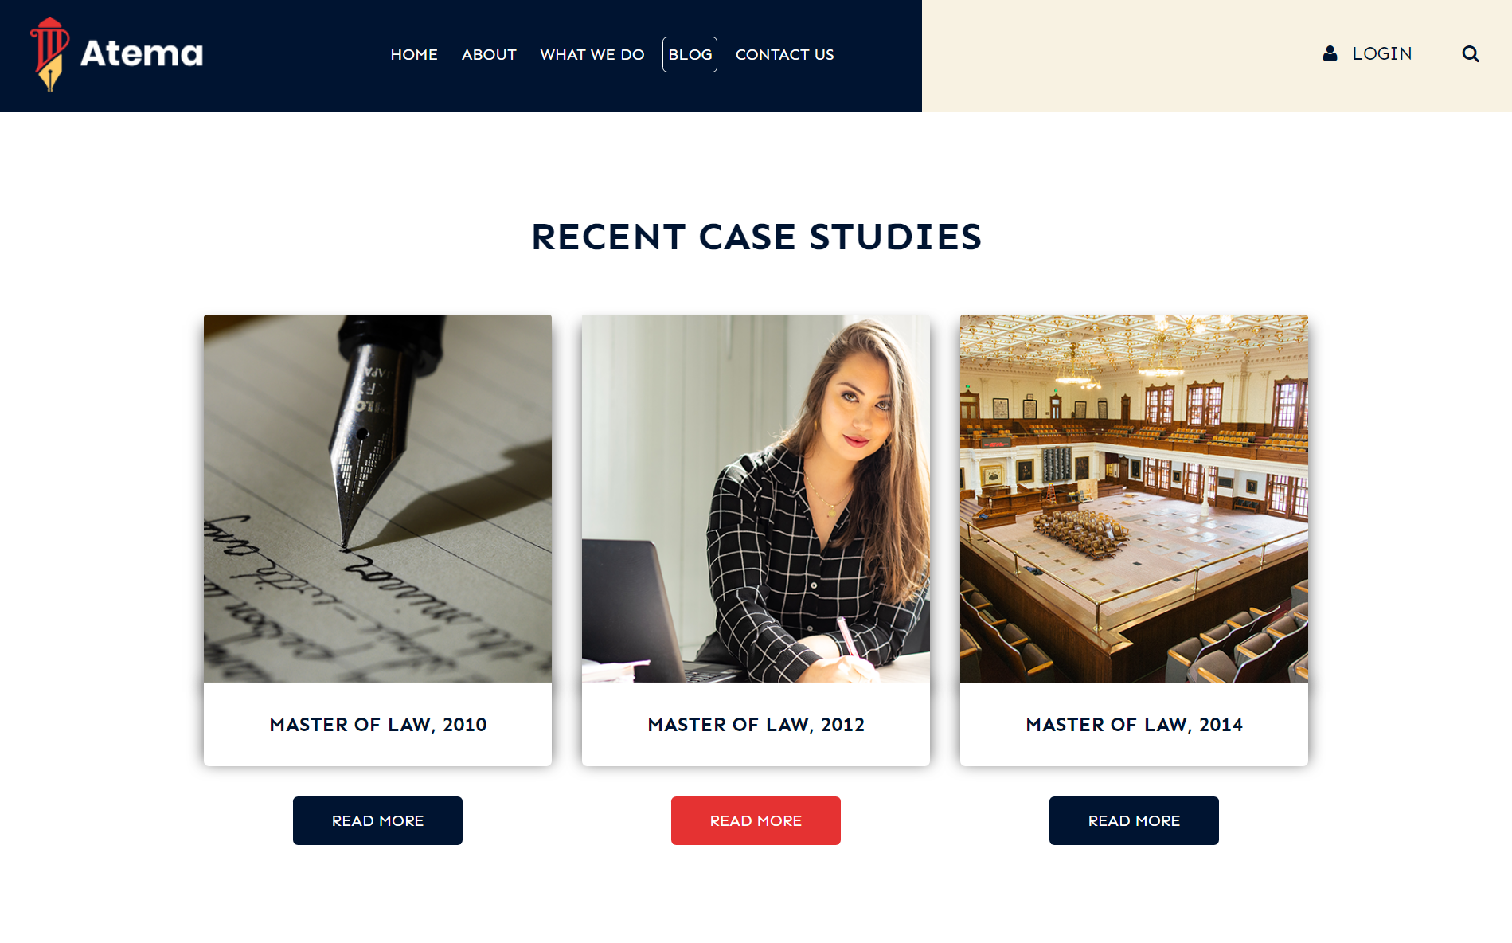
This Is Our Blog Sections. We Post Here All The Updates Regarding New Laws And Guidelines Frequently To Make Our Clints Updated. And Also We Post Here Our Case Studies About Students And Law Firms.

Slide 6
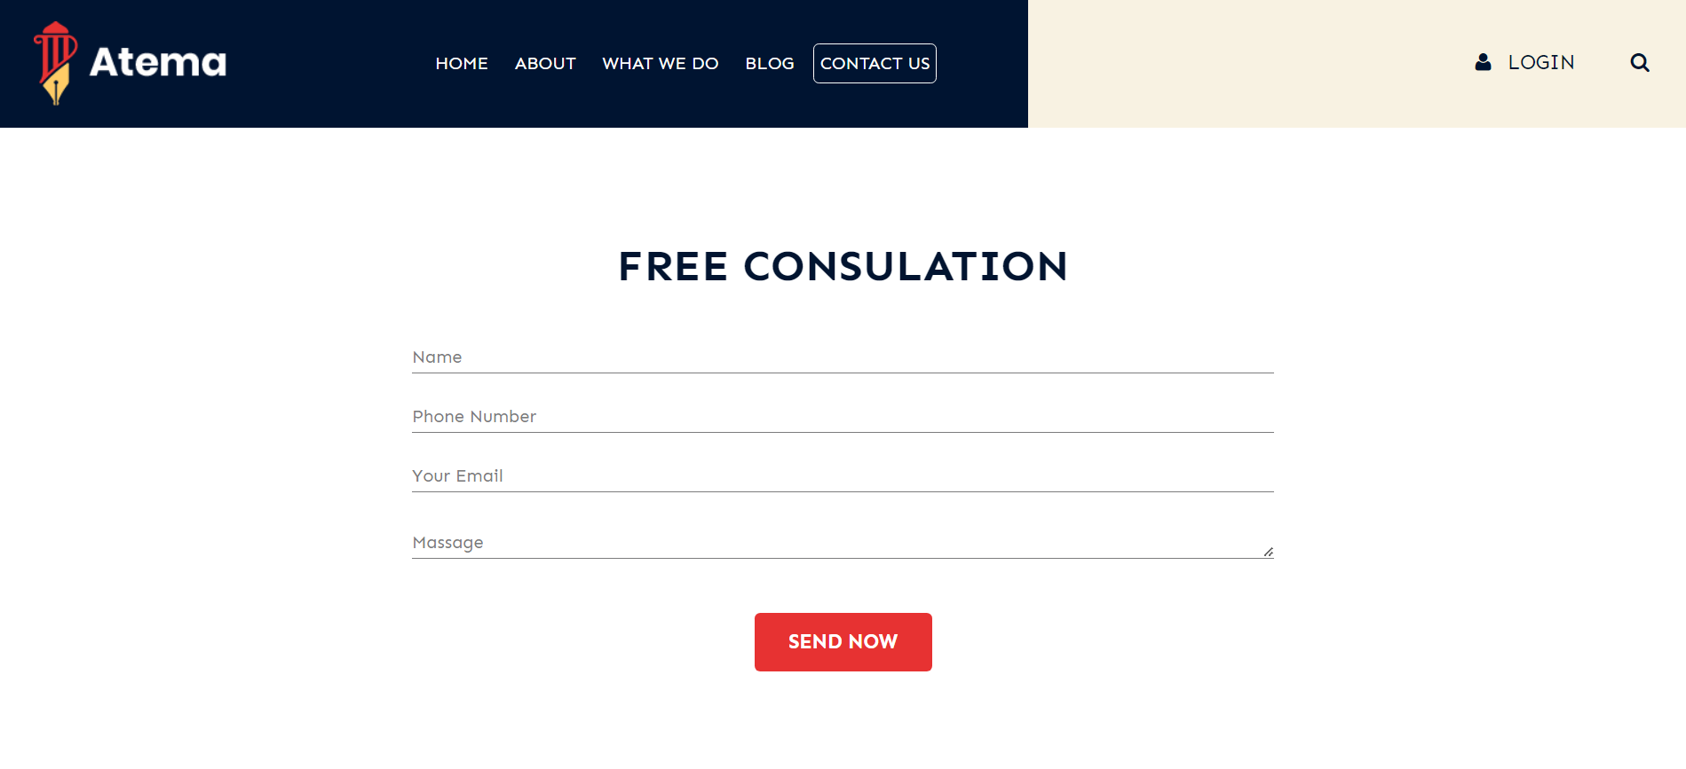
This Is Our Contact Us Page. You Can Raise Any Queries Regarding To Our Works Or Details From Here
We Used High End encryption system to make our user data and queries secured.
We Have 24x7 Support Team To Make Our Clints Satisfied For Firm Support.

Slide 7

.
Our Website Is Created By StaRK Industries Which Is Welled Know For Advance Security And Privacy Works.
We Have Use Third Party Security From Stark Industries Who Proctect Our Website From Malware And Virus Attacts.
We Have Used Advance Data Recovery Softwares To Make Our Website More Reliable And Protected

Slide 8
Languages From Our Website Is Made. HTML CSS JAVASCRIPT

Slide 9
THANK YOU SO MUCH
The PPT Is Ended Here.

